Slide 1
DesENHO organizaCional
10
10 - 1

Slide 2
objetivos
Descrever os seis elementos chave do desenho organizacional.
Contrastar as estruturas mecanicistas e orgânicas.
Discutir os fatores contingenciais que favorecem o desenho organizacional mecanicista e orgânico.
Descrever os desenhos organizacionais tradicionais.
10 - 2

Slide 3
EsTRUTURA OrganizaCional
Organizar
Definir e estruturar o trabalho, para atingir os objetivos da organização.
Estrutura Organizacional – a disposição formal das tarefas/funções dentro da organização.
10 - 3
Notes:
Organizing is arranging and structuring work to accomplish organizational goals. It’s an important process during which managers design an organization’s structure. Organizational structure is the formal arrangement of jobs within an organization.

Slide 4
ESTRUTURA OrganizaCional
Organograma – representação gráfica da estrutura de uma organização.
Desenho Organizacional – processo que inclui decisões sobre seis elementos:
    Especialização do trabalho
    Departamentalização
    Cadeia de comando (hierarquia)
    Amplitude de comando
    Centralização e descentralização
    Formalização
10 - 4
Notes:
Structure can be shown visually in an organizational chart. (See Exhibit 10-1.) When managers create or change the structure, they’re engaged in organizational design, a process that involves decisions about six key elements: work specialization, departmentalization, chain of command, span of control, centralization and decentralization, and formalization.

Slide 5
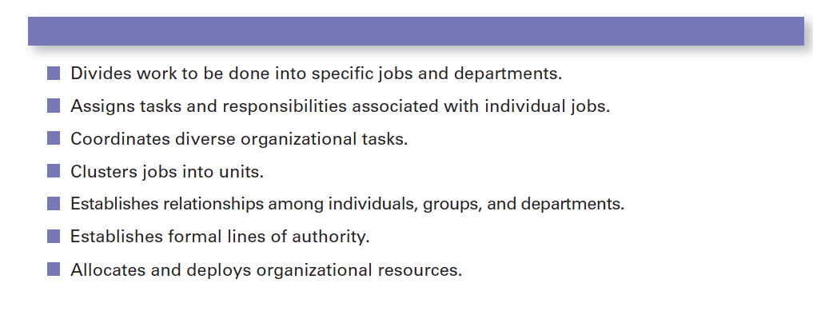
Figura 10-1
Objetivos da organização
10 - 5

Slide 6
ESTRUTURA OrganizaCional
Especialização do trabalho – divisão das atividades de trabalho em tarefas de âmbito mais reduzido.
Os primeiros proponentes da especialização do trabalho acreditavam que esta poderia resultar em aumentos de produtividade.
  Uma especialização excessiva pode resultar em custos relacionados com os recursos humanos
  ex.: tédio, fadiga, stress, baixa qualidade, aumento do absentismo e do turnover (demissões).
10 - 6
Notes:
Work specialization is dividing work activities into separate job tasks. Individual employees “specialize” in doing part of an activity rather than the entire activity in order to increase work output. It’s also known as division of labor. Work specialization makes efficient use of the diversity of workers skills.
Early proponents of work specialization believed it could lead to great increases in productivity. At the beginning of the twentieth century, that generalization was reasonable. Because specialization was not widely practiced, its introduction almost always generated higher productivity.
But, as Exhibit 10-2 illustrates, a good thing can be carried too far. At some point, the human diseconomies from division of labor—boredom, fatigue, stress, low productivity, poor quality, increased absenteeism, and high turnover—exceed the economic advantages.

Slide 7
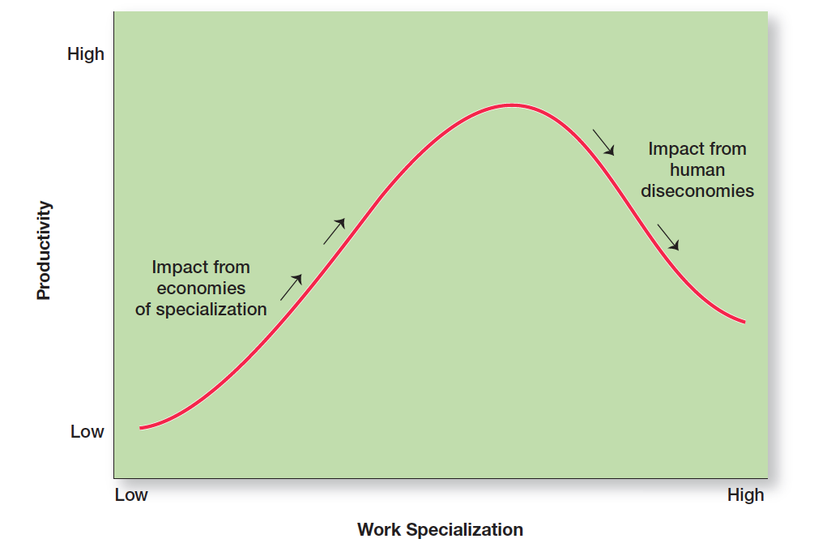
Figura 10-2
EconomiAs e DEseconomiAs da Especialização do trabalho
10 - 7

Slide 8
DepartmentalizaçÃO
Departamentalização – modo como as tarefas são agrupadas na organização. Formas:
Funcional
  Agrupamento por funções realizadas.
Produto
  Agrupamento por linhas de produtos.
Geográfica
  Agrupamento por territórios, ou áreas geográficas.
Processo
  Agrupamento por fluxos.
Cliente
  Agrupamento por tipo de clientes e suas necessidade.
10 - 8
Notes:
How jobs are grouped together is called departmentalization. Five common forms of departmentalization are used, although an organization may develop its own unique classification. Exhibit 10-3 illustrates each type of departmentalization as well as the advantages and disadvantages of each.

Slide 9
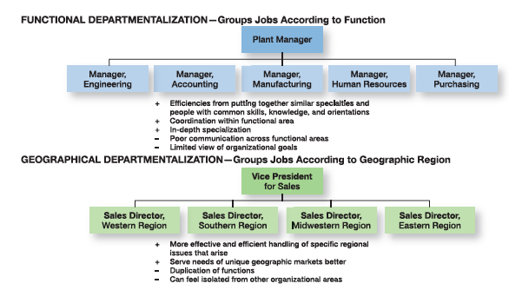
Figura 10-3
As cinco formas mais Comuns de departamentalização
10 - 9

Slide 10
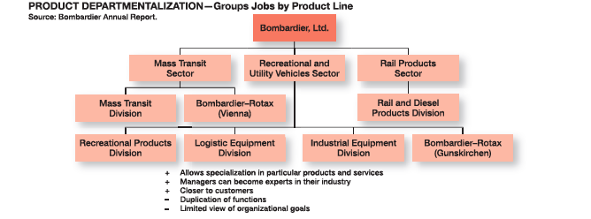
Figura 10-3
(CONT.)
10 - 10

Slide 11
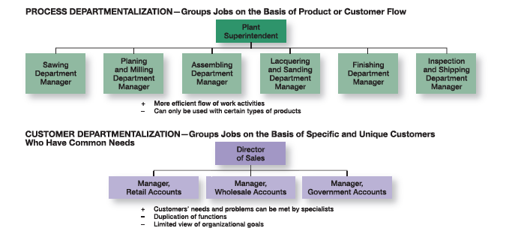
figura 10-3
(CONT.)
10 - 11

Slide 12
TendÊncias da Departmentalização
Departamentalização com base nos clientes – Verifica-se um aumento do uso da departamentalização com base nos clientes.
Equipas multidisciplinares – equipas de trabalho compostas por indivíduos de várias especialidades funcionais.
10 - 12
Notes:
One popular departmentalization trend is the increasing use of customer departmentalization. Because getting and keeping customers is essential for success, this approach works well because it emphasizes monitoring and responding to changes in customers’ needs.
Another popular trend is the use of teams, especially as work tasks have become more complex and diverse skills are needed to accomplish those tasks.
One specific type of team that more organizations are using is a cross-functional team, a work team composed of individuals from various functional specialties.

Slide 13
Cadeia de Comando
Cadeia de comando
Linha continua de autoridade que se estende desde a gestão de topo até aos níveis mais baixos da organização — clarifica quem manda em quem e quem reporta a quem.
10 - 13
Notes:
The chain of command is the line of authority extending from upper organizational levels to lower levels, which clarifies who reports to whom. Managers need to consider it when organizing work because it helps employees with questions such as “Who do I report to?” or “Who do I go to if I have a problem?” To understand the chain of command, you have to understand three other important concepts: authority, responsibility, and unity of command. Let’s look first at authority.

Slide 14
Autoridade
Autoridade
Direito inerente à posição de gestor, que permite dizer às pessoas o que têm de fazer e partir do princípio que estas o farão.
Teoria da aceitação da autoridade – visão que a autoridade é resultado da vontade do subordinado de a aceitar.
10 - 14
Notes:
Authority refers to the rights inherent in a managerial position to tell people what to do and to expect them to do it. Managers in the chain of command have authority to do their job of coordinating and overseeing the work of others. Authority can be delegated downward to lower-level managers, giving them certain rights while also prescribing certain limits within which to operate.
Chester Barnard, proposed another perspective on authority. This view, the acceptance theory of authority, says that authority comes from the willingness of subordinates to accept it. If an employee didn’t accept a manager’s order, there was no authority.

Slide 15
Autoridade (cont.)
Linha de Autoridade – relação hierárquica de autoridade que dá a um gestor o direito para dirigir o trabalho de um subordinado.
Função de assessor (staff authority) – posição com alguma autoridade, criada para apoiar, assistir e aconselhar os que têm relações hierárquicas de autoridade.
10 - 15
Notes:
Line authority entitles a manager to direct the work of an employee. It is the employer–employee authority relationship that extends from the top of the organization to the lowest echelon, according to the chain of command, as shown in Exhibit 10-4. As a link in the chain of command, a manager with line authority has the right to direct the work of employees and to make certain decisions without consulting anyone.
As organizations get larger and more complex, line managers find that they do not have the time, expertise, or resources to get their jobs done effectively. In response, they create staff authority functions to support, assist, advise, and generally reduce some of their informational burdens. For instance, a hospital administrator who cannot effectively handle the purchasing of all the supplies the hospital needs creates a purchasing department, which is a staff function.

Slide 16
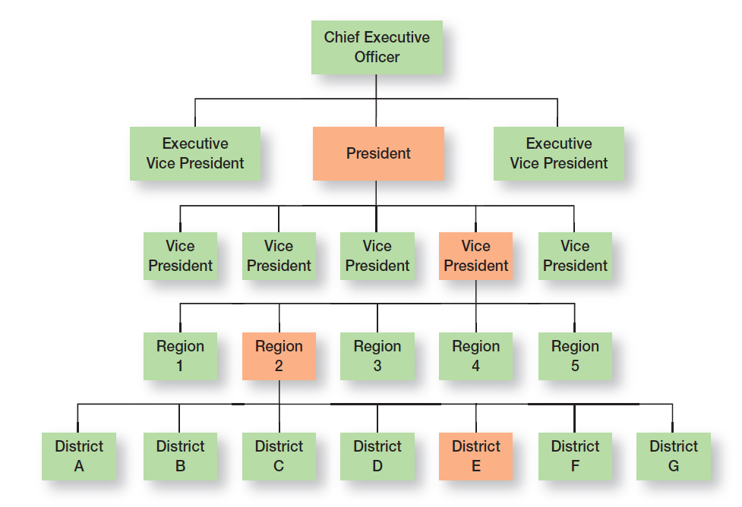
Figura 10-4 Cadeia de Comando e linha de Autoridade
10 - 16

Slide 17
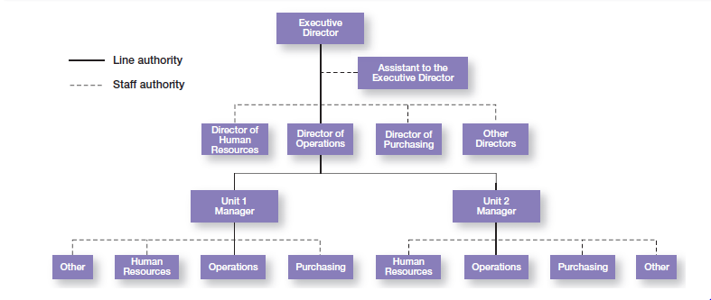
figura 10-5
Autoridade de linha e autoridade de staff
10 - 17

Slide 18
Responsabilidade e Unidade de Comando
Responsabilidade – obrigação ou expectativa de fazer algo.
Unidade de comando – princípio de gestão segundo o qual cada pessoa deveria reportar apenas a um gestor.
10 - 18
Notes:
When managers use their authority to assign work to employees, those employees take on an obligation to perform those assigned duties. This obligation or expectation to perform is known as responsibility. And employees should be held accountable for their performance! Assigning work authority without responsibility and accountability can create opportunities for abuse. Likewise, no one should be held responsible or accountable for work tasks over which he or she has no authority to complete.
Finally, the unity of command principle (one of Fayol’s 14 management principles) states that a person should report to only one manager. Without unity of command, conflicting demands from multiple bosses may create problems.

Slide 19
Amplitude de Controlo
Amplitude de controlo
O número de empregados que um gestor pode gerir de forma eficaz e eficiente.
10- 19
Notes:
How many employees can a manager efficiently and effectively manage? That’s what span of control is all about. The traditional view was that managers could not—and should not—directly supervise more than five or six subordinates. Determining the span of control is important because to a large degree, it determines the number of levels and managers in an organization—an important consideration in how efficient an organization will be. All other things being equal, the wider or larger the span, the more efficient the organization.
Assume two organizations both have approximately 4,100 employees. As Exhibit 10-6 shows, if one organization has a span of four and the other a span of eight, the organization with the wider span will have two fewer levels and approximately 800 fewer managers.

Slide 20
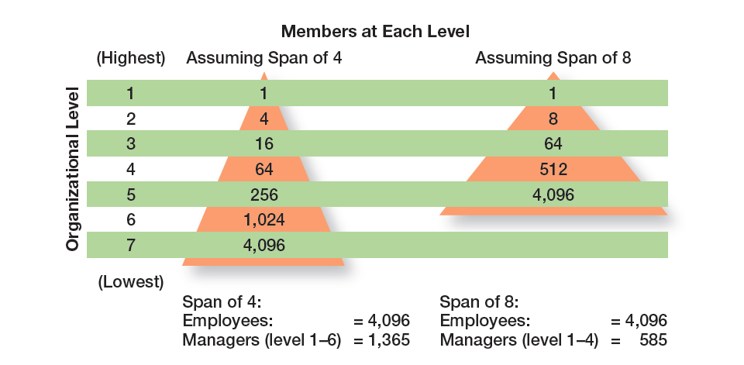
figura 10-6 diferentes amplitudes de Controlo
10 - 20

Slide 21
Centralização e Decentralização
Centralização – grau de concentração do processo de tomada de decisão nos níveis hierárquicos mais elevados da organização.
Descentralização – grau em que os níveis hierárquicos mais baixos da organização podem tomar decisões, ou contribuir para a tomada de decisão.
Dar poder aos empregados (empowerment) – dar mais autoridade (poder) para tomar decisões.
10 - 21
Notes:
“At what organizational level are decisions made?” Centralization is the degree to which decision-making takes place at the upper levels of the organization. If top managers make key decisions with little input from below, then the organization is more centralized. On the other hand, the more that lower-level employees provide input or actually make decisions, the more decentralization there is. Keep in mind that centralization-decentralization is not an either-or concept. The decision is relative, not absolute—that is, an organization is never completely centralized or decentralized.
As organizations have become more flexible and responsive to environmental trends, there’s been a distinct shift toward decentralized decision-making. This trend, also known as employee empowerment, gives employees more authority (power) to make decisions.

Slide 22
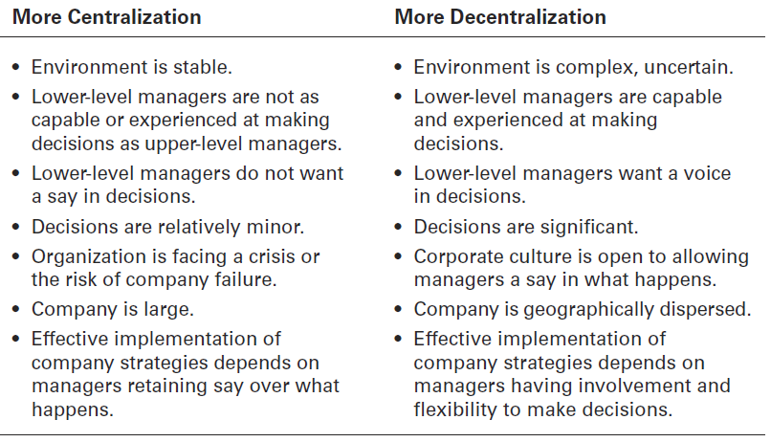
Figura 10-7
Centralização e Descentralização
10 - 22
Notes:
Exhibit 10-7 lists some of the factors that affect an organization’s use of centralization or decentralization.

Slide 23
Formalização
Formalização – grau de estandardização do trabalho na organização e grau em que o comportamento dos empregados é determinado por regras e procedimentos.
  Funções com elevado grau de formalização dão pouco espaço de manobra aos indivíduos para decidirem o que deve ser feito.
  A baixa formalização implica menos restrições à forma como os indivíduos fazem o seu trabalho.
10 - 23
Notes:
Formalization refers to how standardized an organization’s jobs are and the extent to which employee behavior is guided by rules and procedures. In highly formalized organizations, there are explicit job descriptions, numerous organizational rules, and clearly defined procedures covering work processes. Employees have little discretion over what’s done, when it’s done, and how it’s done. However, where formalization is low, employees have more discretion in how they do their work.

Slide 24
Estruturas Mecanicistas e Orgânicas
Organização mecanicista – desenho organizacional rígido e com um elevado nível de controlo.
Organização orgânica – desenho organizacional altamente flexível e adaptável.
10 - 24
Notes:
The mechanistic organization (or bureaucracy) was the natural result of combining the six elements of structure. Adhering to the chain-of-command principle ensured the existence of a formal hierarchy of authority, with each person controlled and supervised by one superior. Keeping the span of control small at increasingly higher levels in the organization created tall, impersonal structures. As the distance between the top and the bottom of the organization expanded, top management would increasingly impose rules and regulations. Because top managers couldn’t control lower-level activities through direct observation and ensure the use of standard practices, they substituted rules and regulations.
The organic organization is a highly adaptive form that is as loose and flexible as the mechanistic organization is rigid and stable. Rather than having standardized jobs and regulations, the organic organization’s loose structure allows it to change rapidly as required. It has division of labor, but the jobs people do are not standardized. Employees tend to be professionals who are technically proficient and trained to handle diverse problems. They need few formal rules and little direct supervision because their training has instilled in them standards of professional conduct.

Slide 25
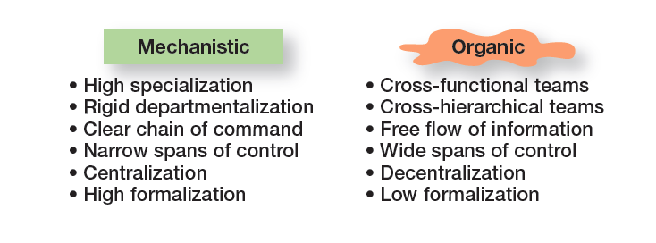
figura 10-8 organizações Mecanicistas Ve OrgÂnicas
10 - 25
Notes:
Basic organizational design revolves around two organizational forms, described in Exhibit 10-8.

Slide 26
Fatores Contingenciais que afetam A escolha da estrutura
Estratégia e Estrutura
  Mudanças na estratégia da organização devem levar a uma reflexão sobre a estrutura que melhor se adequará à implementação dessa estratégia..
10 - 26
Notes:
An organization’s structure should facilitate goal achievement. Because goals are an important part of the organization’s strategies, it’s only logical that strategy and structure are closely linked.
Research has shown that certain structural designs work best with different organizational strategies. For instance, the flexibility and free-flowing information of the organic structure works well when an organization is pursuing meaningful and unique innovations. The mechanistic organization with its efficiency, stability, and tight controls works best for companies wanting to tightly control costs.

Slide 27
Fatores Contingenciais que afetam A escolha da estrutura
Estratégia e Estrutura
  Alguns desenhos organizacionais funcionam melhor com determinadas estratégias organizacionais.
    Estruturas orgânicas são mais apropriadas para organizações que pretendem ser inovadoras.
    Estruturas mecanicistas são mais apropriadas para organizações que baseiam a sua estratégia no baixo custo.
10 - 26
Notes:
An organization’s structure should facilitate goal achievement. Because goals are an important part of the organization’s strategies, it’s only logical that strategy and structure are closely linked.
Research has shown that certain structural designs work best with different organizational strategies. For instance, the flexibility and free-flowing information of the organic structure works well when an organization is pursuing meaningful and unique innovations. The mechanistic organization with its efficiency, stability, and tight controls works best for companies wanting to tightly control costs.

Slide 28
Fatores contingenciais (cont.)
Dimensão e Estrutura
À medida que uma organização cresce, a sua estrutura tende a mudar de um desenho orgânico para um desenho mecanicista, com crescente especialização do trabalho, departamentalização, centralização e definição de regras e regulamentos.
10 - 27
Notes:
There’s considerable evidence that an organization’s size affects its structure. Large organizations—typically considered to be those with more than 2,000 employees— tend to have more specialization, departmentalization, centralization, and rules and regulations than do small organizations. However, once an organization grows past a certain size, size has less influence on structure. Why? Essentially, once there are around 2,000 employees, it’s already fairly mechanistic. Adding another 500 employees won’t impact the structure much. On the other hand, adding 500 employees to an organization with only 300 employees is likely to make it more mechanistic.

Slide 29
Fatores contingenciais (cont.)
Tecnologia e Estrutura
As organizações adaptam as suas estruturas à sua tecnologia.
Segundo Woodward, consoante a complexidade da tecnologia utilizada, as organizações podem classificar-se da seguinte forma:
    Produção unitária – reduzido número de outputs.
    Produção em massa - grandes números de outputs.
    Produção continua – processo contínuo de outputs.
10 - 28
Notes:
Every organization uses some form of technology to convert its inputs into outputs. The initial research on technology’s effect on structure can be traced to Joan Woodward, who studied small manufacturing firms in southern England to determine the extent to which structural design elements were related to organizational success. She couldn’t find any consistent pattern until she divided the firms into three distinct technologies that had increasing levels of complexity and sophistication. The first category, unit production, described the production of items in units or small batches. The second category, mass production, described large batch manufacturing. Finally, the third and most technically complex group, process production, included continuous-process production. A summary of her findings is shown in Exhibit 10-9.

Slide 30
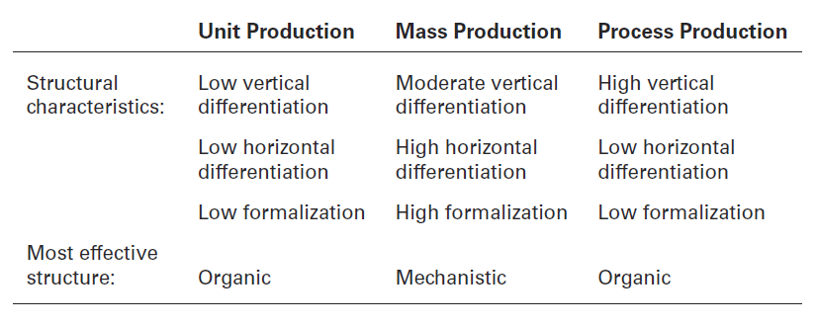
FIGURA 10-9
PESQUISA DE Woodward SOBRE tecnologia e estrutura
10 - 29

Slide 31
Fatores Contingenciais (cont.)
Incerteza ambiental e estrutura
  Estruturas organizacionais mecanicistas tendem a ser mais eficazes em ambientes simples e estáveis.
  A flexibilidade das estruturas organizacionais orgânicas é mais apropriada para ambientes complexos e dinâmicos.
10 - 30
Notes:
Some organizations face stable and simple environments with little uncertainty; others face dynamic and complex environments with a lot of uncertainty. Managers try to minimize environmental uncertainty by adjusting the organization’s structure. The evidence on the environment-structure relationship helps explain why so many managers today are restructuring their organizations to be lean, fast, and flexible. Worldwide economic downturns, global competition, accelerated product innovation by competitors, and increased demands from customers for high quality and faster deliveries are examples of dynamic environmental forces. Mechanistic organizations are not equipped to respond to rapid environmental change and environmental uncertainty. As a result, we’re seeing organizations become more organic.

Slide 32
Desenhos organizacionais Tradicionais
Estrutura simples – desenho organizacional com baixa departamentalização, grandes amplitudes de controlo, autoridade centralizada e baixo nível de formalização.
Estrutura funcional – desenho organizacional que agrupa especialidades ocupacionais semelhantes.
Estrutura divisional – desenho organizacional constituído por unidades ou divisões semi-autónomas separadas.
10 - 31
Notes:
Most companies start as entrepreneurial ventures using a simple structure, an organizational design with low departmentalization, wide spans of control, authority centralized in a single person, and little formalization. As employees are added, however, most don’t remain as simple structures. The structure tends to become more specialized and formalized.
A functional structure is an organizational design that groups similar or related occupational specialties together. You can think of this structure as functional departmentalization applied to the entire organization.
The divisional structure is an organizational structure made up of separate business units or divisions. n this structure, each division has limited autonomy, with a division manager who has authority over his or her unit and is responsible for as an external overseer to coordinate and control the various divisions, and often provides support services such as financial and legal.

Slide 33
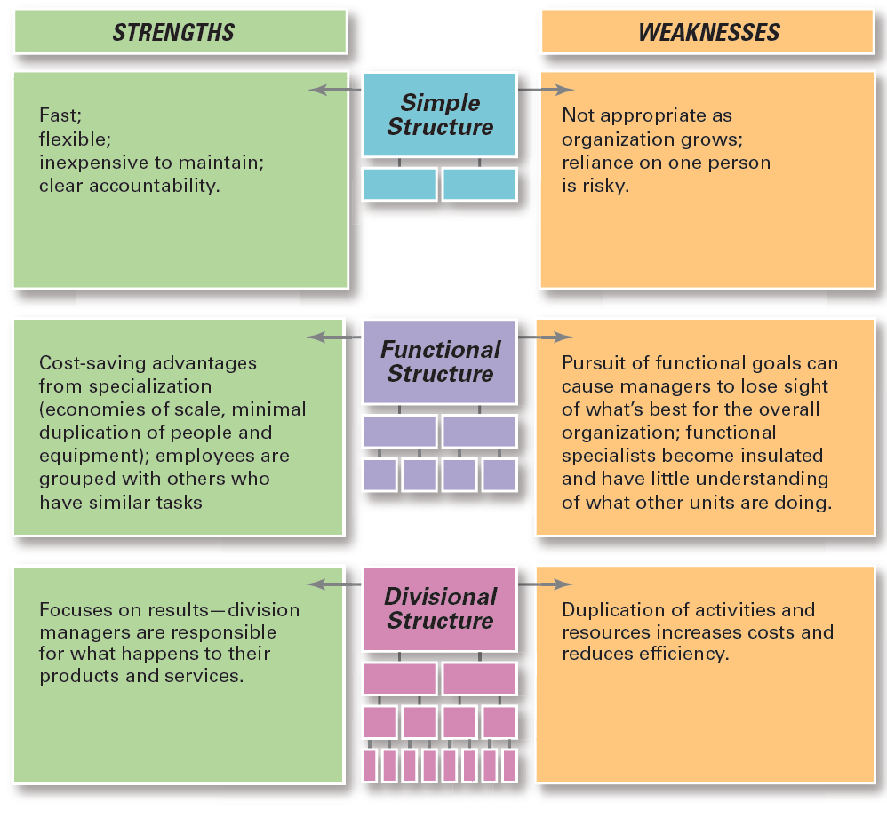
Figura 10-10
Desenhos organizacionais tradicionais
10 - 32
Notes:
When designing a structure, managers may choose one of the traditional organizational designs. These structures tend to be more mechanistic in nature. A summary of the strengths and weaknesses of each can be found in Exhibit 10-10.

Slide 34


